Slide 1

Online Food Order
AN online application to order your favorite food. Implemented as spring MVC application. Db layers are implemented using spring data
Rajalakshmi Elumalai
4797765

Slide 2
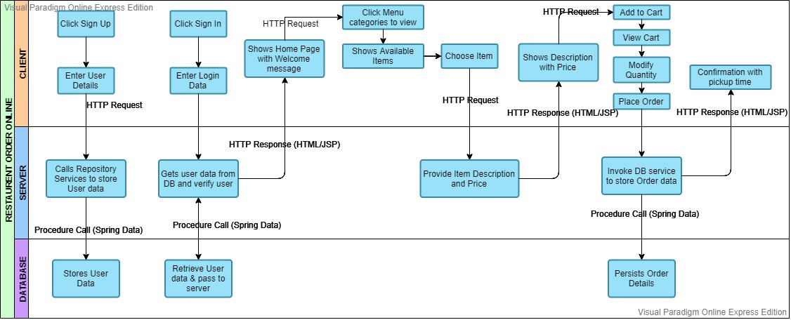
Architecture 1- Client-Server Style

Slide 3
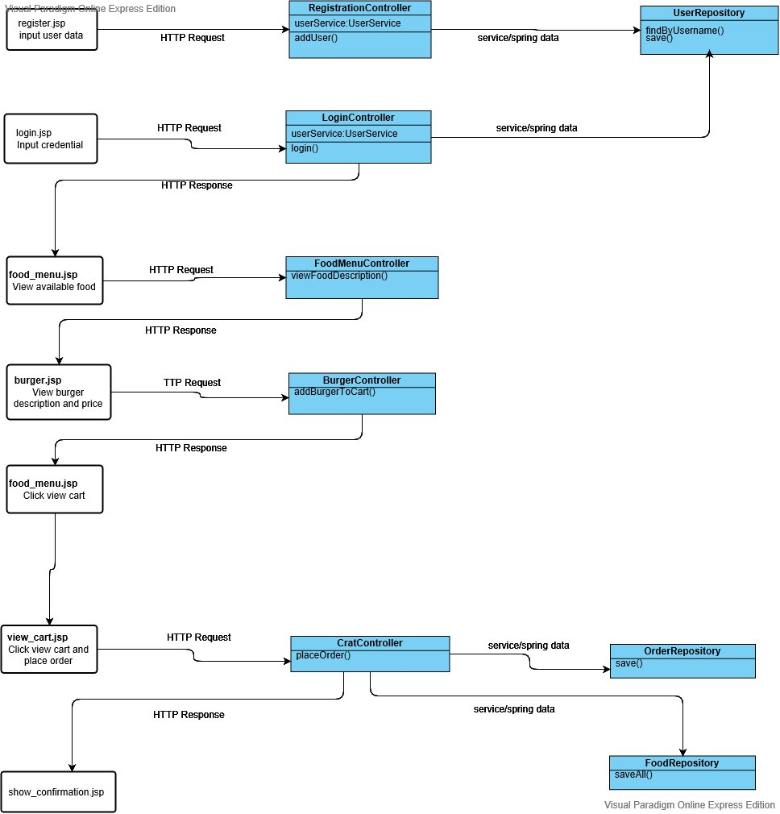
Client-Server Style – class diagram

Slide 4
Client-Server Style – Mapping Architecture to Class diagram
S.No | Category | Architecture | UML | Source Code
1 | UI Component | Enter user data | register.jsp | register.jsp
2 | Component | Call repository service to store user data | RegistrationController | RegistrationController.java
3 | Component | Stores user data | UserRepository | UserRepository.java
4 | Component | Enter login data | login.jsp | login.jsp
5 | Component | Gets user data from DB and verify | LoginController | LoginController.java
6 | Component | Retrieve user data and pass back to server | UserRepository | UserRepository.java
7 | UI component | Shows available food items | food_menu.jsp | food_menu.jsp
8 | Component | Shows available food items | FoodMenuController | FoodMenuController.java

Slide 5
Client-Server Style – Mapping Architecture to Class diagram (continued..)
9 | UI component | Add to cart | burger.jsp | burger.jsp
10 | Component | Provide food description and price | BurgerController | BurgerController.java
11 | UI component | View cart & modify quantity, place order | view_crat.jsp | view_crat.jsp
12 | Component | Invoke DB service to persist order | CartController | CartController.java
13 | Component | Persist order | OrderRepositor FoodRepository | OrderRepositor.java FoodRepository.java
14 | UI component | Confirmation with pickup time | Show_confirmation.jsp | Show_confirmation.jsp
15 | Connector | HTTP Request | HTTP Request | <Jsp:form action=action name>
16 | Connector | HTTP Response | HTTP Response | ModelAndView(jsp file name)
17 | Connector | Procedure call | Service and Spring Data procedure call | userService.methodname() repository.methodname()

Slide 6
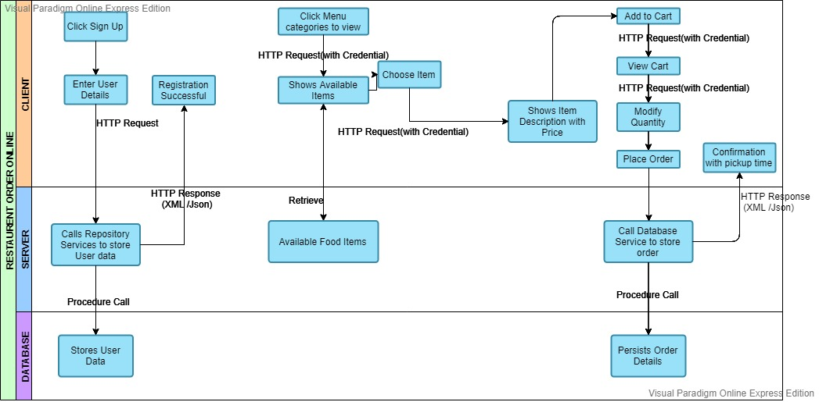
Architecture 2- Representational state transfer(REST) style

Slide 7
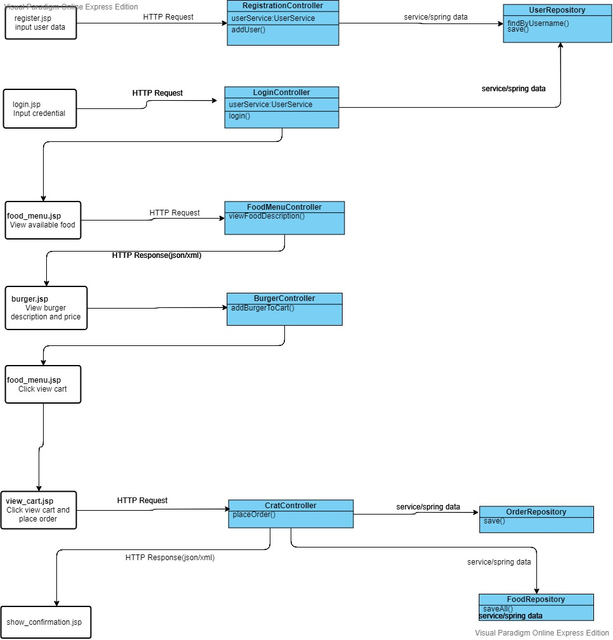
REST Style – class diagram

Slide 8
REST Style – Mapping Architecture to Class diagram
S.No | Category | Architecture | UML | Source Code
1 | UI Component | Enter user data | register.jsp | register.jsp
2 | Component | Call repository service to store user data | RegistrationController | RegistrationController.java
3 | Component | Stores user data | UserRepository | UserRepository.java
4 | Component | Enter login data | login.jsp | login.jsp
5 | Component | Gets user data from DB and verify | LoginController | LoginController.java
6 | Component | Retrieve user data and pass back to server | UserRepository | UserRepository.java
7 | UI component | Shows available food items | food_menu.jsp | food_menu.jsp
8 | Component | Shows available food items | FoodMenuController | FoodMenuController.java

Slide 9
REST Style – Mapping Architecture to Class diagram (continued..)
9 | UI component | Add to cart | burger.jsp | burger.jsp
10 | Component | Provide food description and price | BurgerController | BurgerController.java
11 | UI component | View cart & modify quantity, place order | view_crat.jsp | view_crat.jsp
12 | Component | Invoke DB service to persist order | CartController | CartController.java
13 | Component | Persist order | OrderRepositor FoodRepository | OrderRepositor.java FoodRepository.java
14 | UI component | Confirmation with pickup time | Show_confirmation.jsp | Show_confirmation.jsp
15 | Connector | HTTP Request | HTTP Request | HTTP request URI
16 | Connector | HTTP Response | HTTP Response | JSON or XML
17 | Connector | Procedure call | Service and Spring Data procedure call | userService.methodname() repository.methodname()

Slide 10
Client-Server vs REST architecture
Client – Server Style
Pros |  | Cons
Centralization | Entire application is controlled by server All the requests from client are managed by the server | Overloaded Server | When no.of clients increased, response rate of the server gets reduced.
Easy Management | Codebase or all the files are stored in a single system. So, managing files becomes easy | Not a robust system | Server may go down, when the system load is more. Then the client request to order the food cannot be completed
Scalability | It is type of layered architecture. 1. So, if like to add new food item, just add new entry into ‘food_item’ table. 2. To modify the cart feature, just work with UI layer 3.To upgrade to new versions of technology, just modify maven pom.xml file

Slide 11
Security | It allows only authenticated users. Can enable framework supported security like Spring security
Rich user interface | Can design UI more attractive by including images and graphs, media

Slide 12
REST Style
Pros |  | Cons
Centralization | Entire application is controlled by server Client and server logic is separated All the requests from client are managed by the server | UI Restriction | An UI page cannot contain all kind of responses like image, media, etc. It supports only Json and XML responses. If an UI would like to include a resource, it can only contain the link of the resource (through HATEOAS)
Scalability | Since client and server layers are separated, can include new features to UI without affecting controller and vice versa | Stateless | Since it is stateless, need to pass credential to access each page of the application Server will not maintain the logged in user data till he is signing out.
 |  | Cacheable | As client will not store data in cache, each request is directed to server, it will affect server speed

Slide 13
Rationale of selecting Client-Server Style
Layered Architecture - Add More features
Since client-server architecture follows layered style, In future, can add variety of food items by making entries in DB and adding few UI pages without affecting the existing code
As client and server are separated, modifying UI pages will not affect controller part of the application
Upgrading technology
Can easily upgrade java, spring, MySQL versions by not changing the code. Just need to update dependent jars
Security
As the architecture supports security, would like to include spring security in future
Rich User Interface
Can make application more attractive by including variety of colorful food images and can draw graph for user’s order history

Slide 14
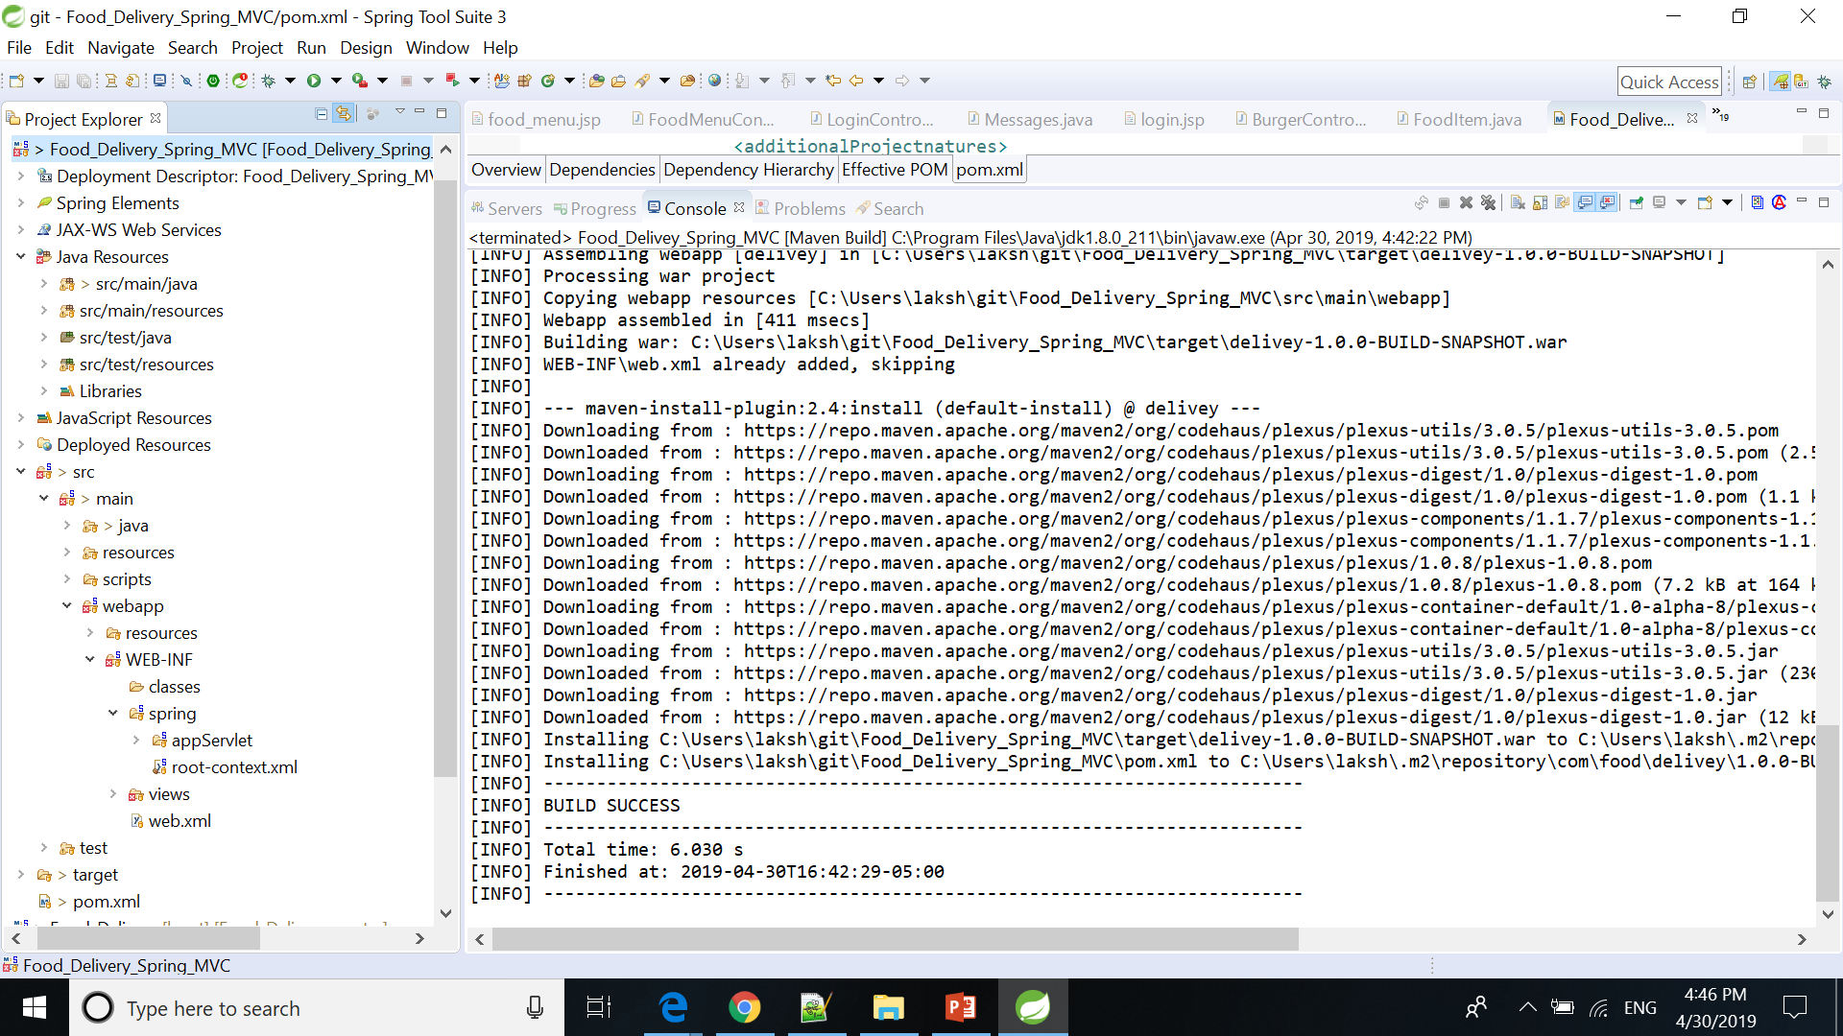
Code Compilation

Slide 15
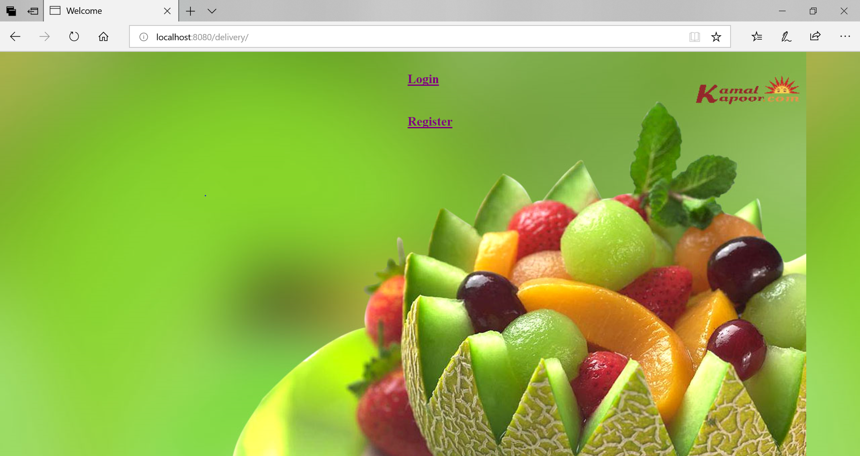
System Execution

Slide 16
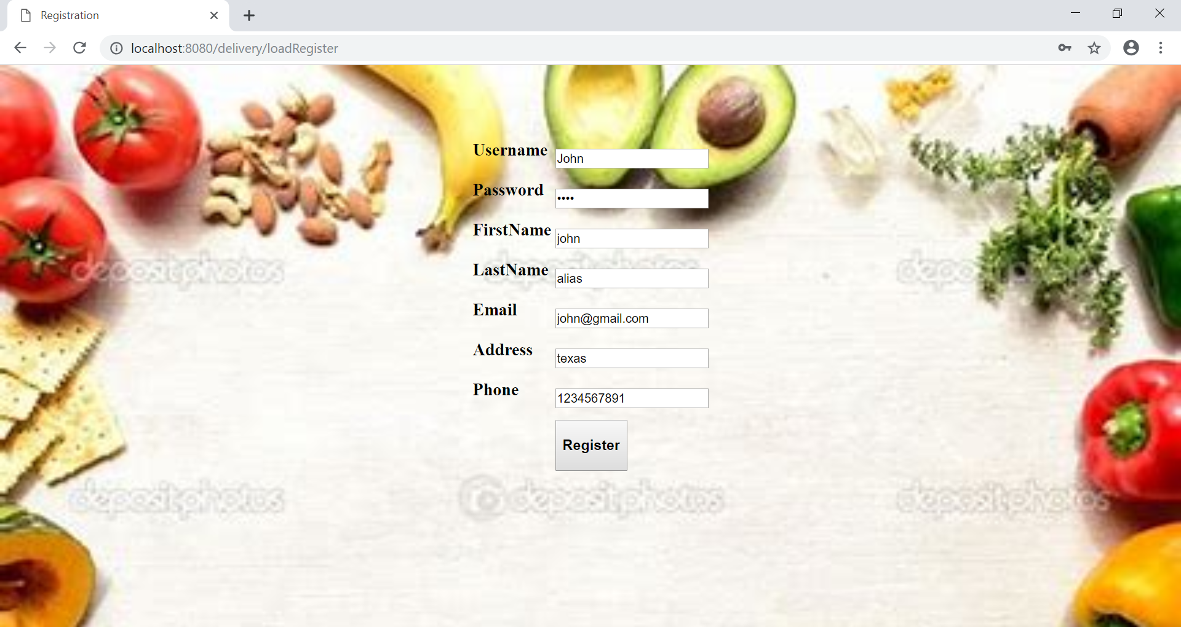
Registration

Slide 17
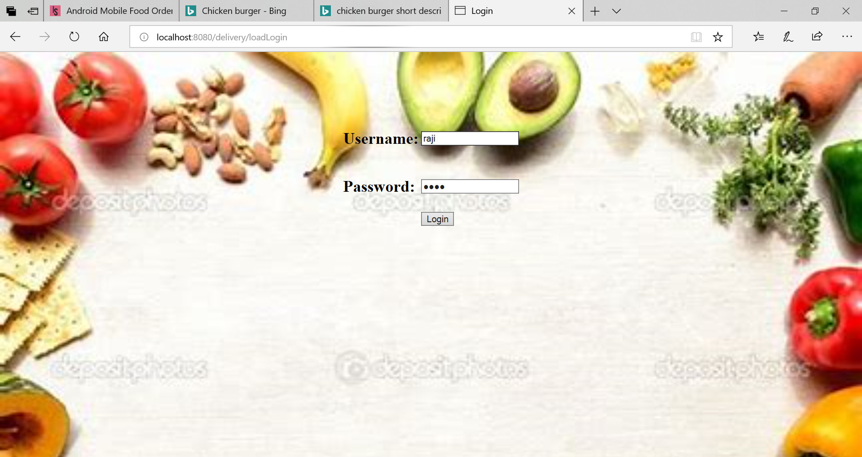
Login

Slide 18
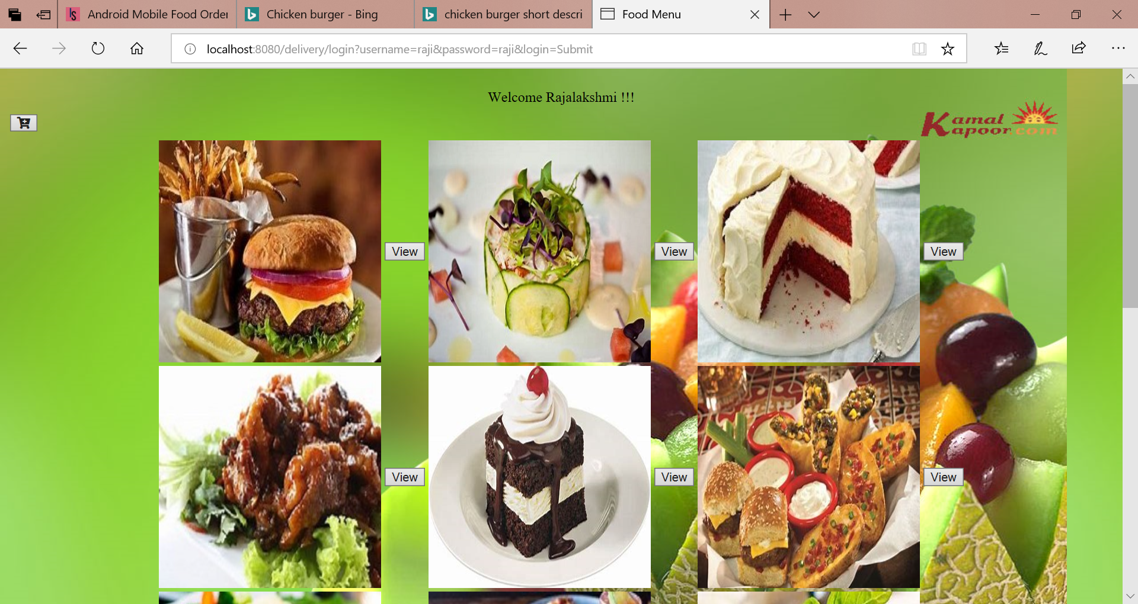
Food Menu page

Slide 19
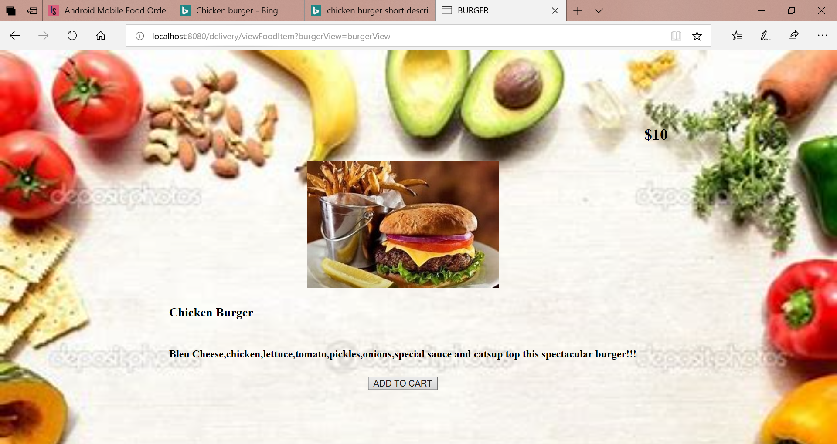
Food Item Information

Slide 20
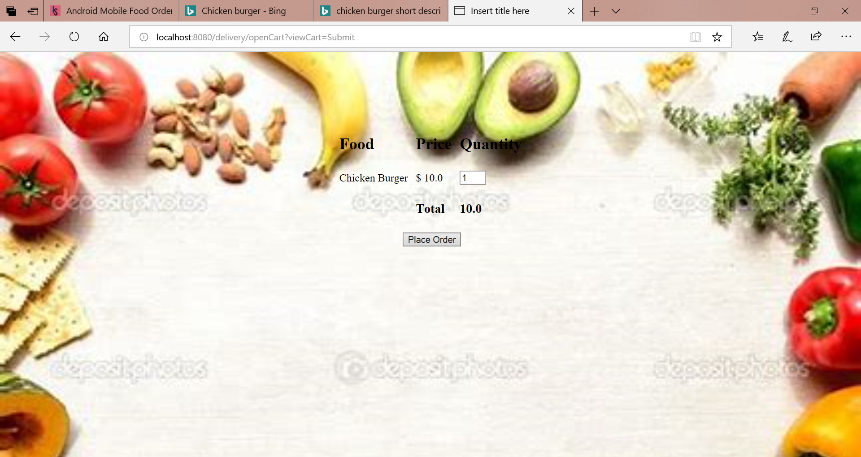
View Cart

Slide 21
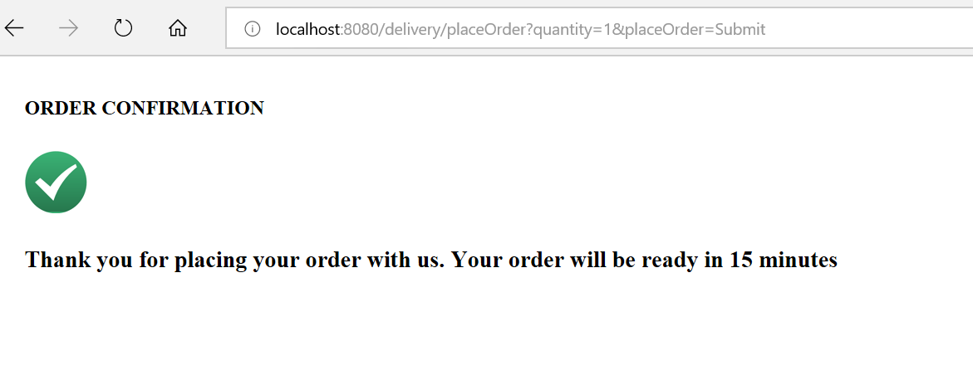
Confirmation

Slide 22
Project Repository
https://github.com/RajalakshmiElumalaiCts/Food_Delivery_Spring_MVC.git
Thank You

